Slide 1
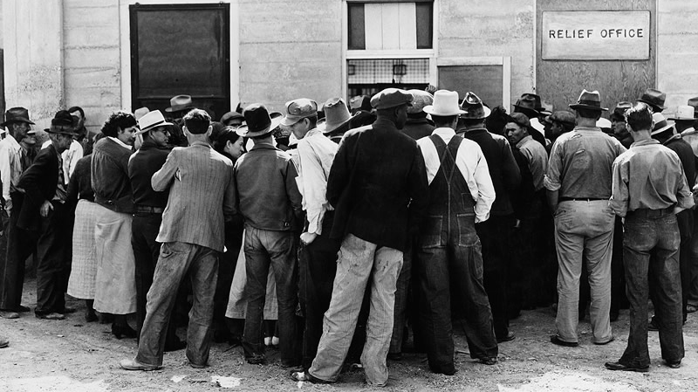

Fate, Responsibility, and “Natural” Disaster Relief: Narrating the American Welfare State by Michele L. Landis
Presented by:
Kimberly S. Bouyer

Slide 2
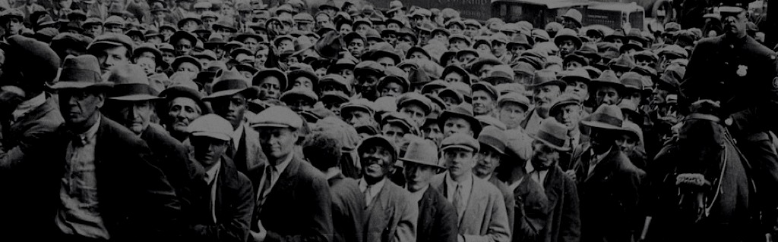

AGENDA
  AUTHOR’S ARGUMENT
  THEORETICAL MODELS
  THE KEY ELEMENTS
  “THE GRAPES OF WRATH”
  RECAP & SHORT VIDEO CLIP

Slide 3
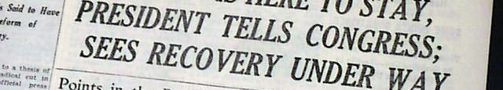
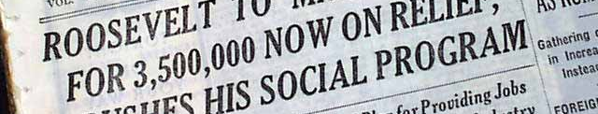
LANDIS’ ARGUMENT

Slide 4
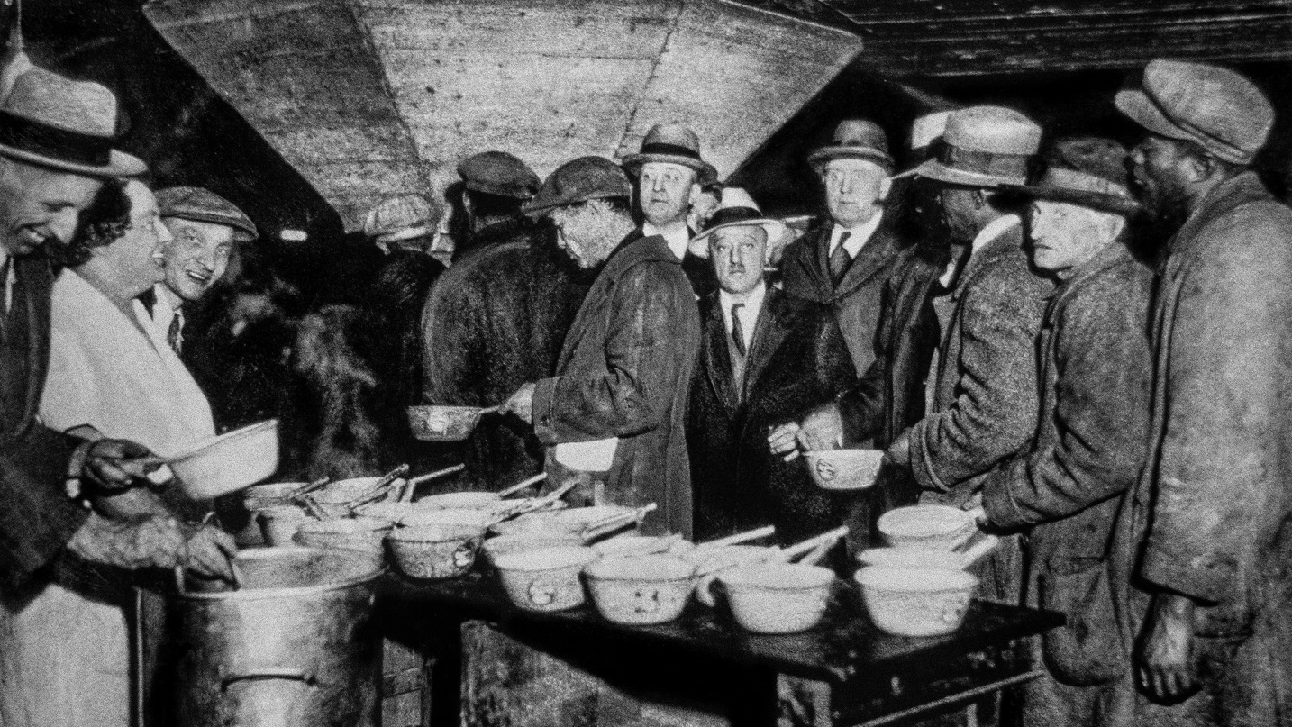
THEORETICAL MODELS
HISTORICISM
CULTURAL STUDIES

Slide 5
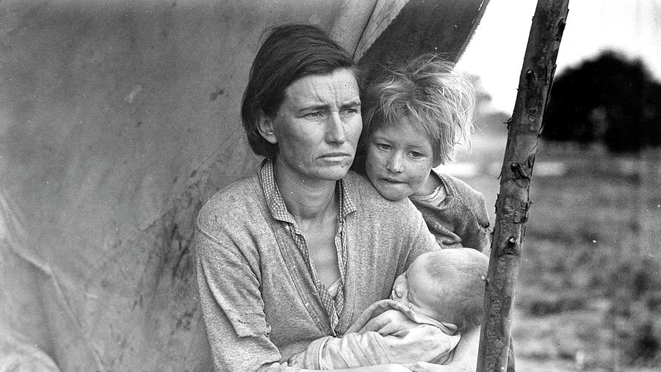
THE NEW DEAL
ENACTED BY FRANKLIN D. ROOSEVELT
LEGAL PRECEDENT
NARRATIVES OF BLAME AND FATE

Slide 6
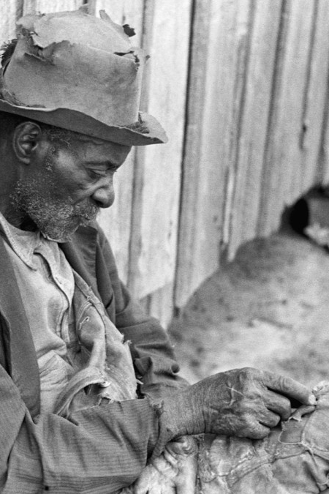
DISASTER RELIEF AND WELFARE STATE THEORY
The “Deserving” vs. “Undeserving” Poor
Welfare Recipients vs. Massachusetts Fisherman
The Narrative of Blamelessness

Slide 7
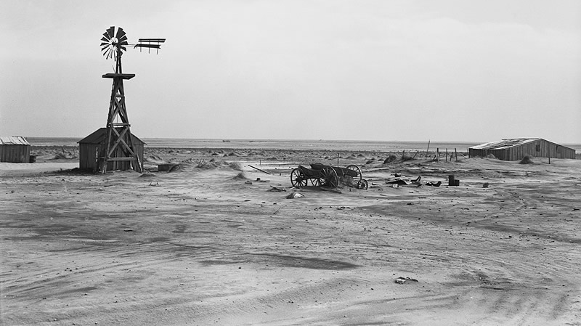
THE GRAPES OF WRATH

Slide 8
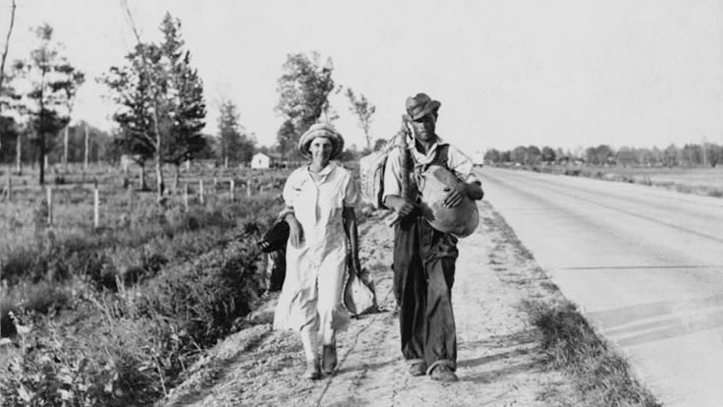
HOW DOES LANDIS’ MAIN AGRUMENT COMPARE TO JOHN STEINBECK’S NOVEL?

Slide 9
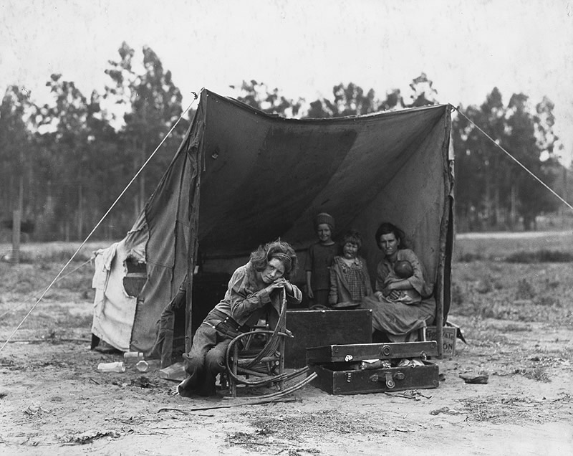
RECAP

Slide 10
