Slide 1
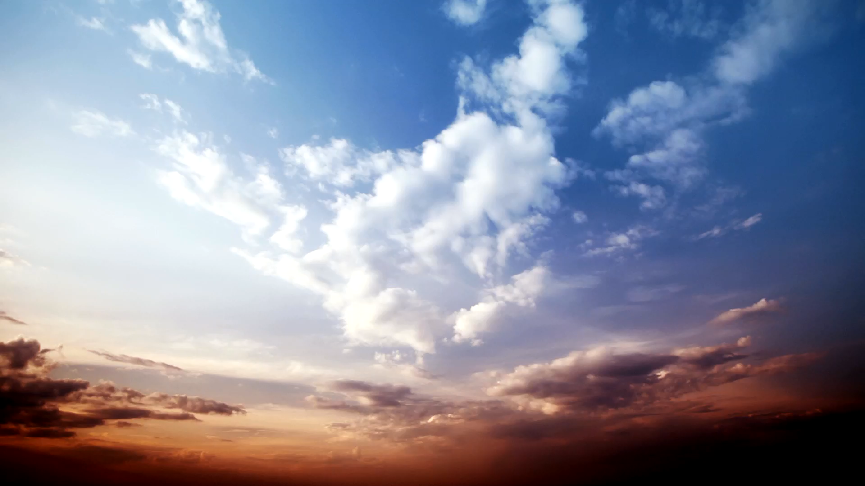

THE TURQUOISE LEDGE
Leslie Marmon Silko
Presented by Kimberly S. Bouyer

Slide 2
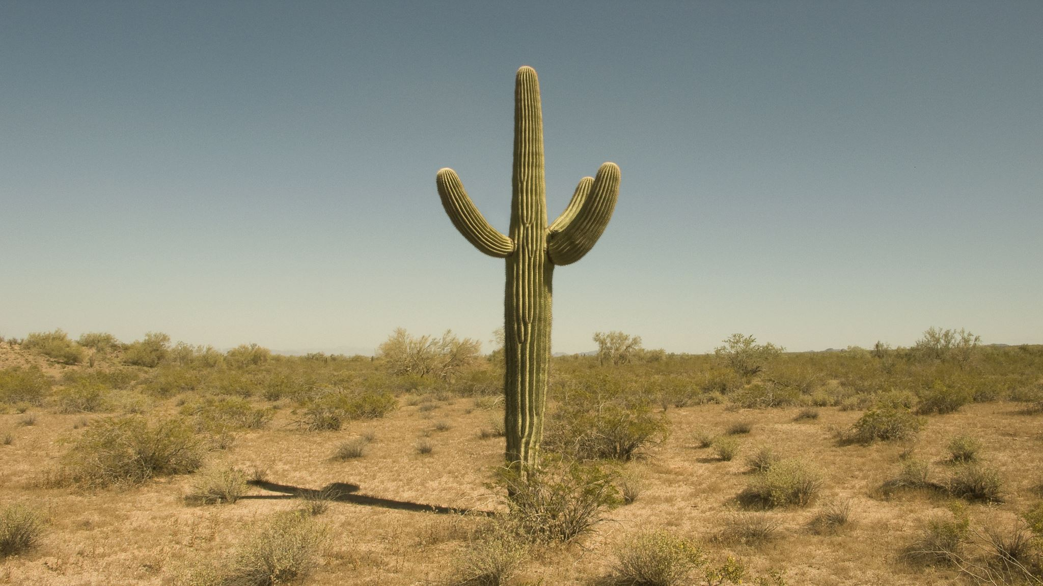
TEXT 1
TEXT 2
WRITING ABOUT PLACE
SILKO AND THE SONORAN DESERT
PLACE AS THE MAIN CHARACTER
SILKO’S OBSERVATIONS AND REFLECTIONS

Slide 3
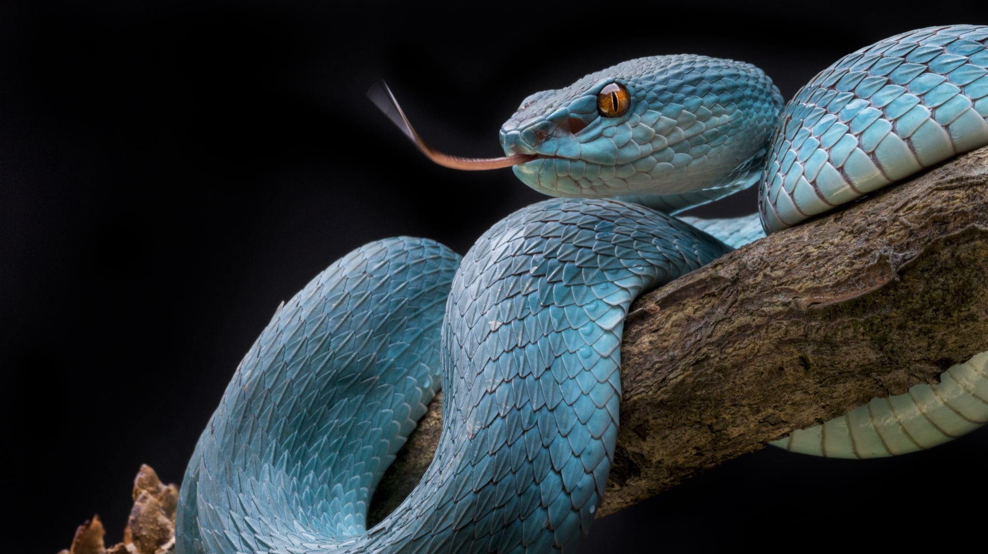
“Rattlesnakes and Radical Resurgence”
INDIGENOUS RESISTANCE PRACTICES
DIVINE MESSENGERS
COLLECTIVE PRESERVATION

Slide 4
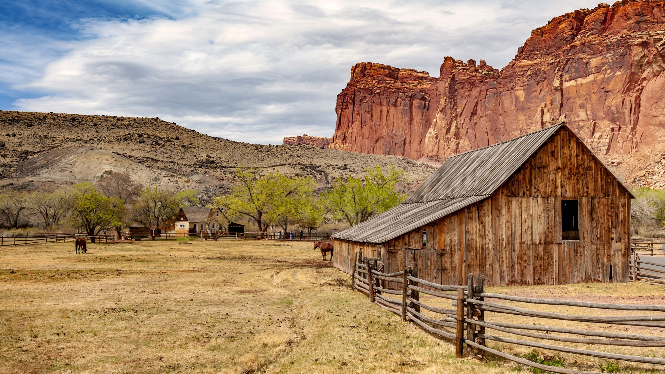
“Fences and Nets”
SETTLER-COLONIAL POSSESSION
A MUTUAL TRUST
DISMANTLING THE SYSTEM

Slide 5
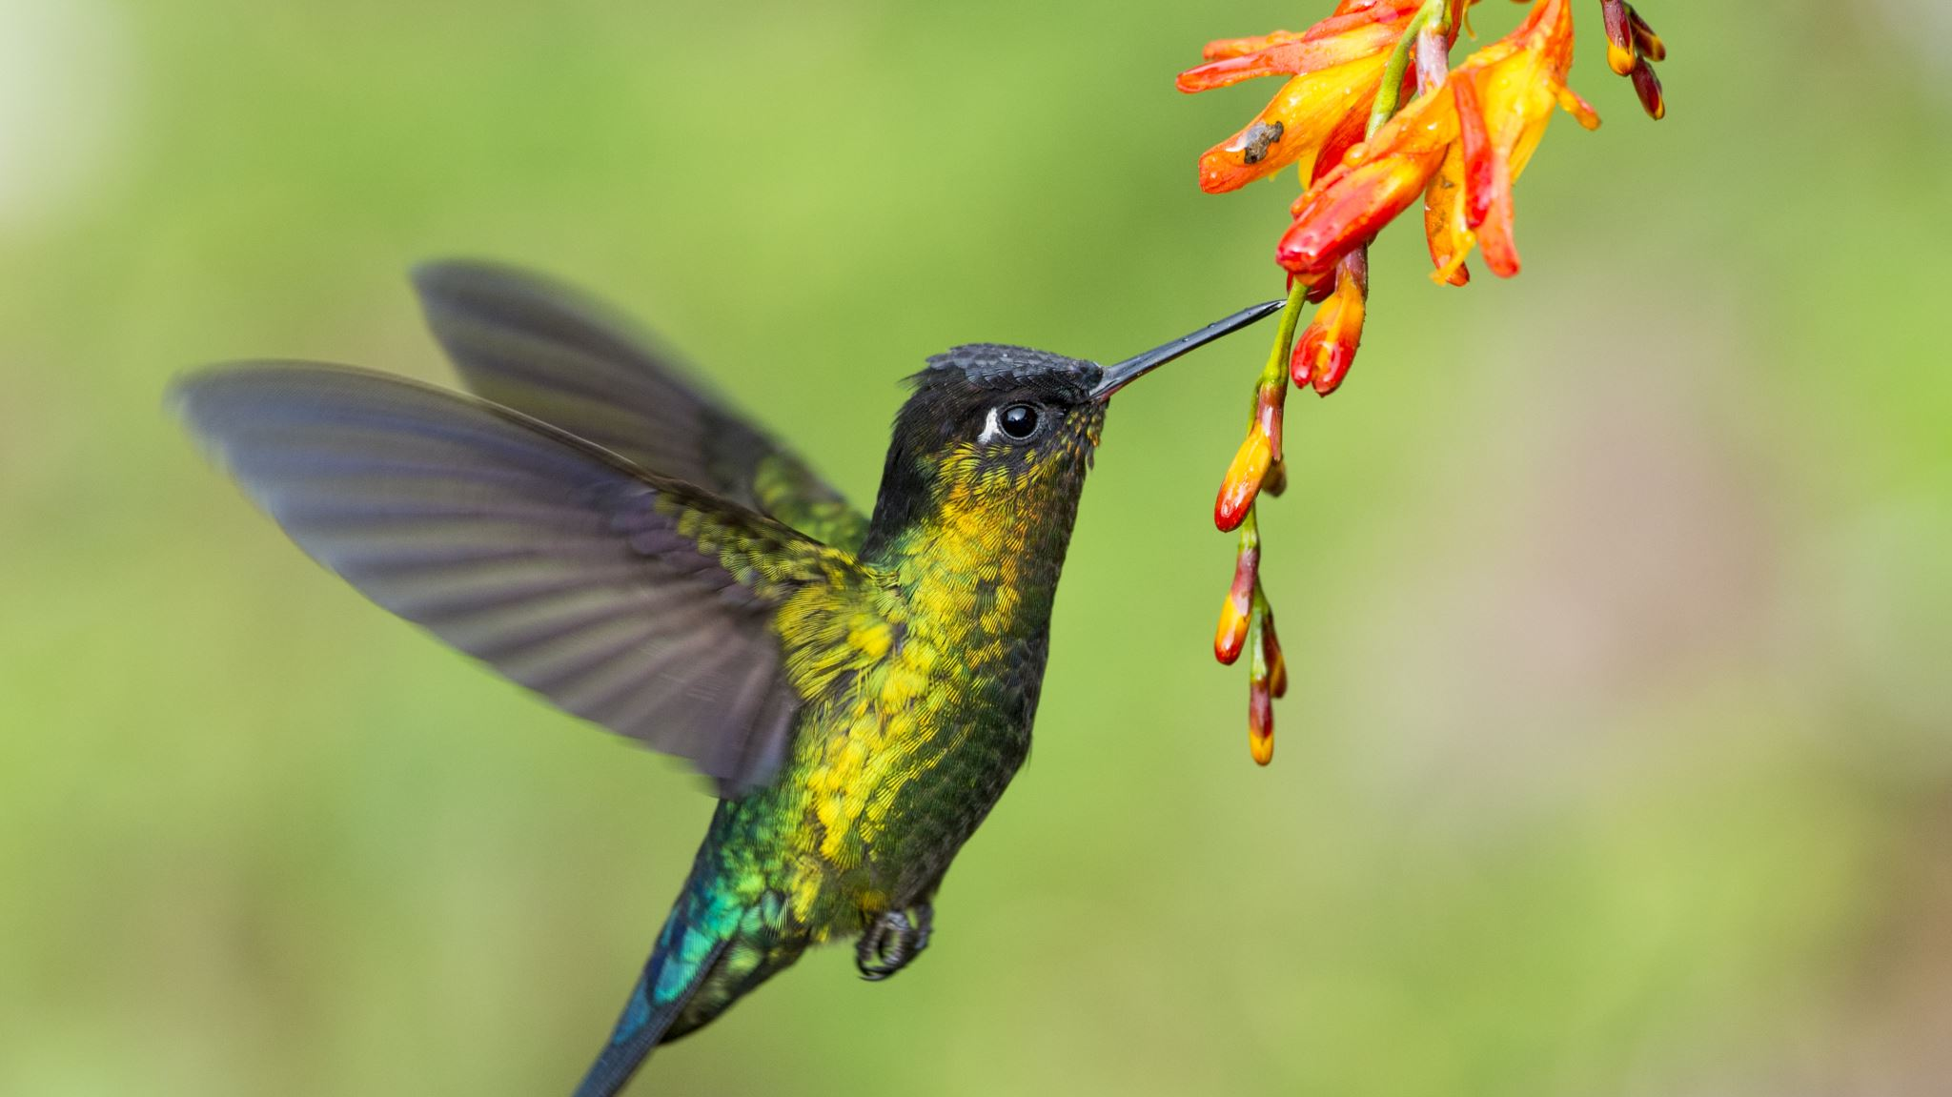
“Radical Resurgence through Art and Landscape”
TURQUOISE AND INDIGENOUS PEOPLE
FEDERAL WATER LAWS
LAGUNA PUEBLO ART

Slide 6
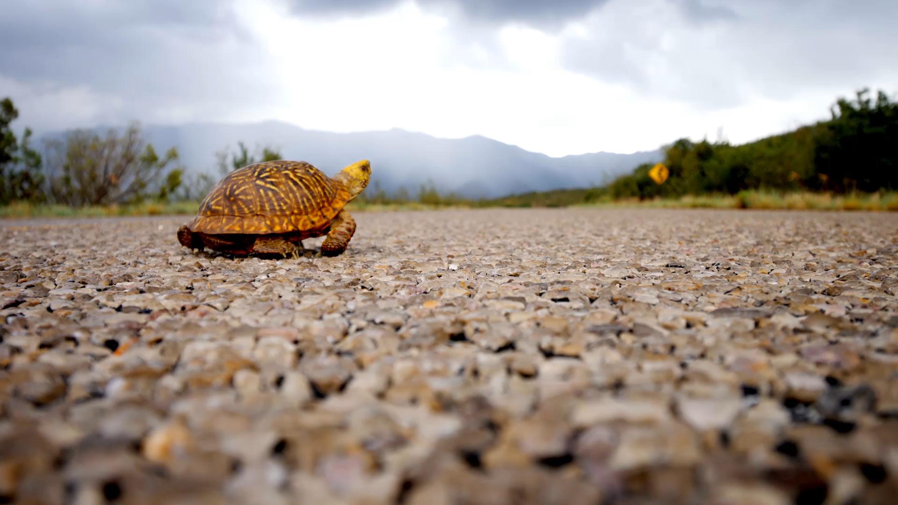
“Self, Genre, and Radical Resurgence”
SILKO’S ANCESTRAL TRADITIONS
THE POWER OF THE STORY
JUSTICE IN THE NARRATIVE

Slide 7
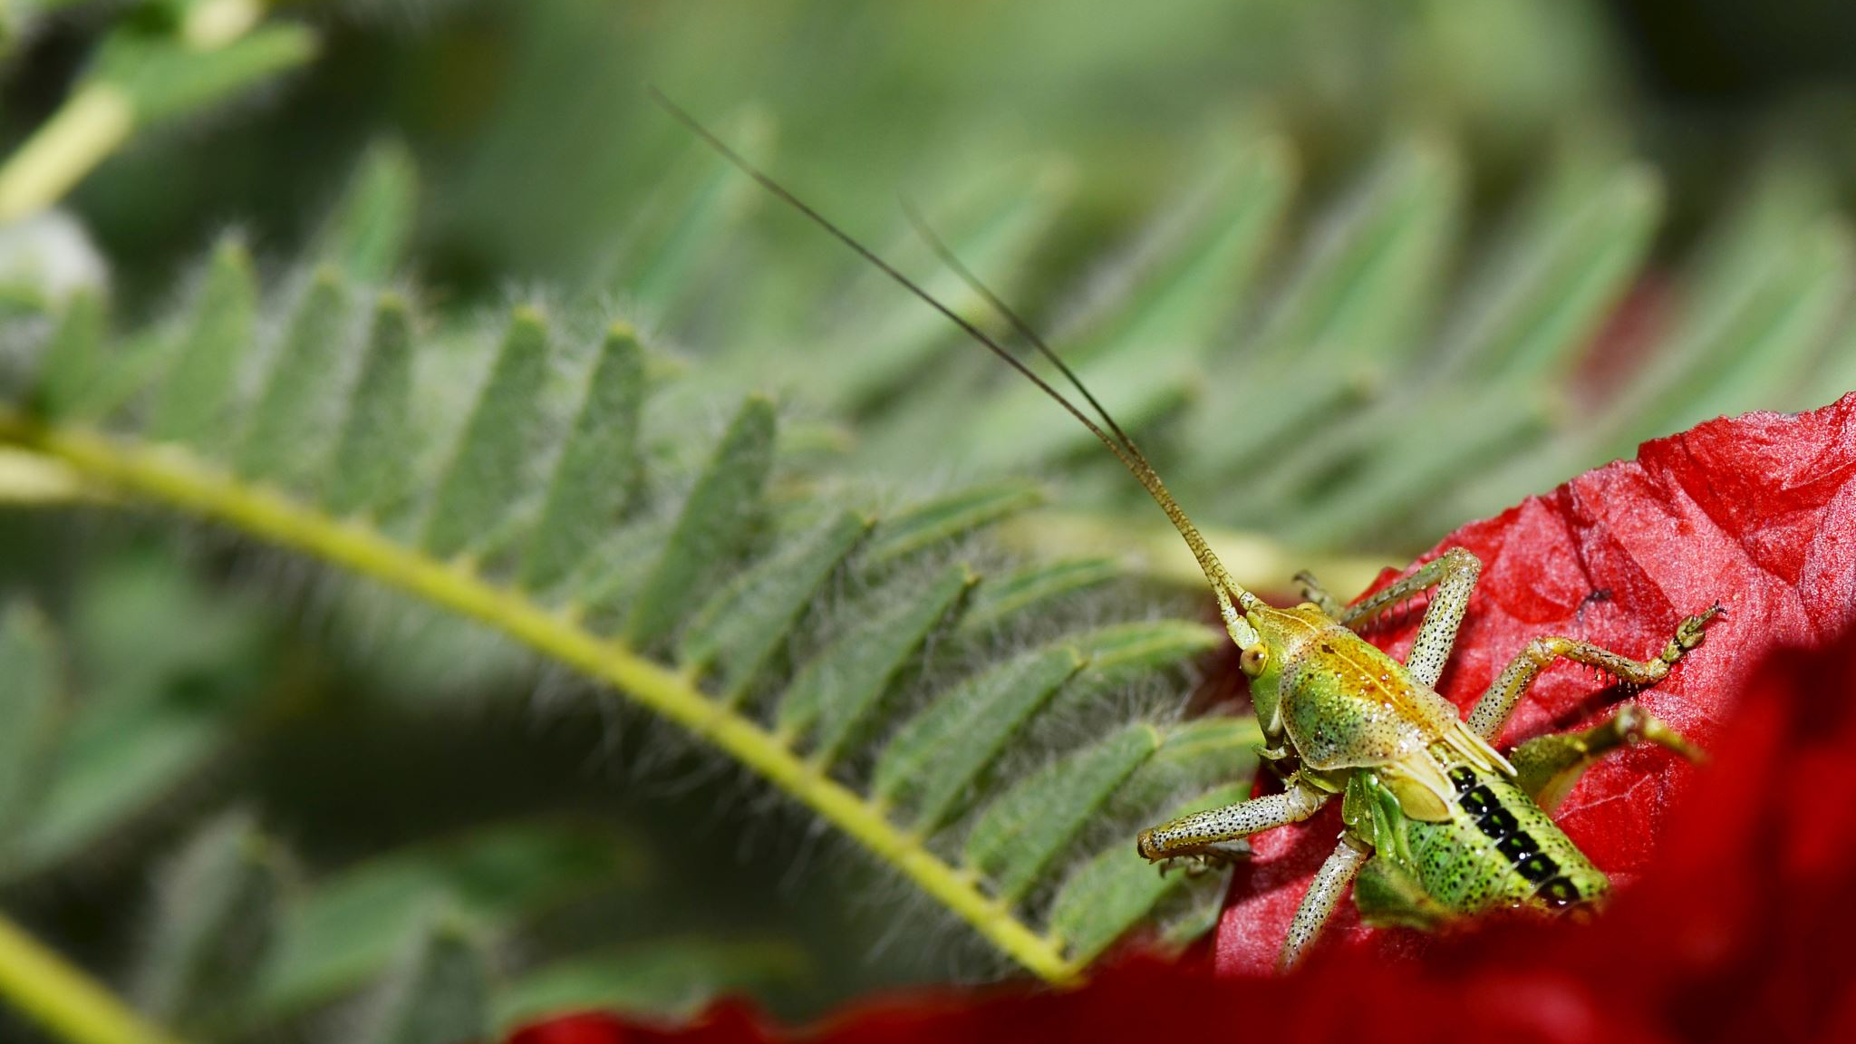
RECAP
Writing about Place
“Rattlesnakes and Radical Resurgence”
“Fences and Nets”
“Radical Resurgence through Art and Landscape”
“Self, Genre, and Radical Resurgence”

Slide 8
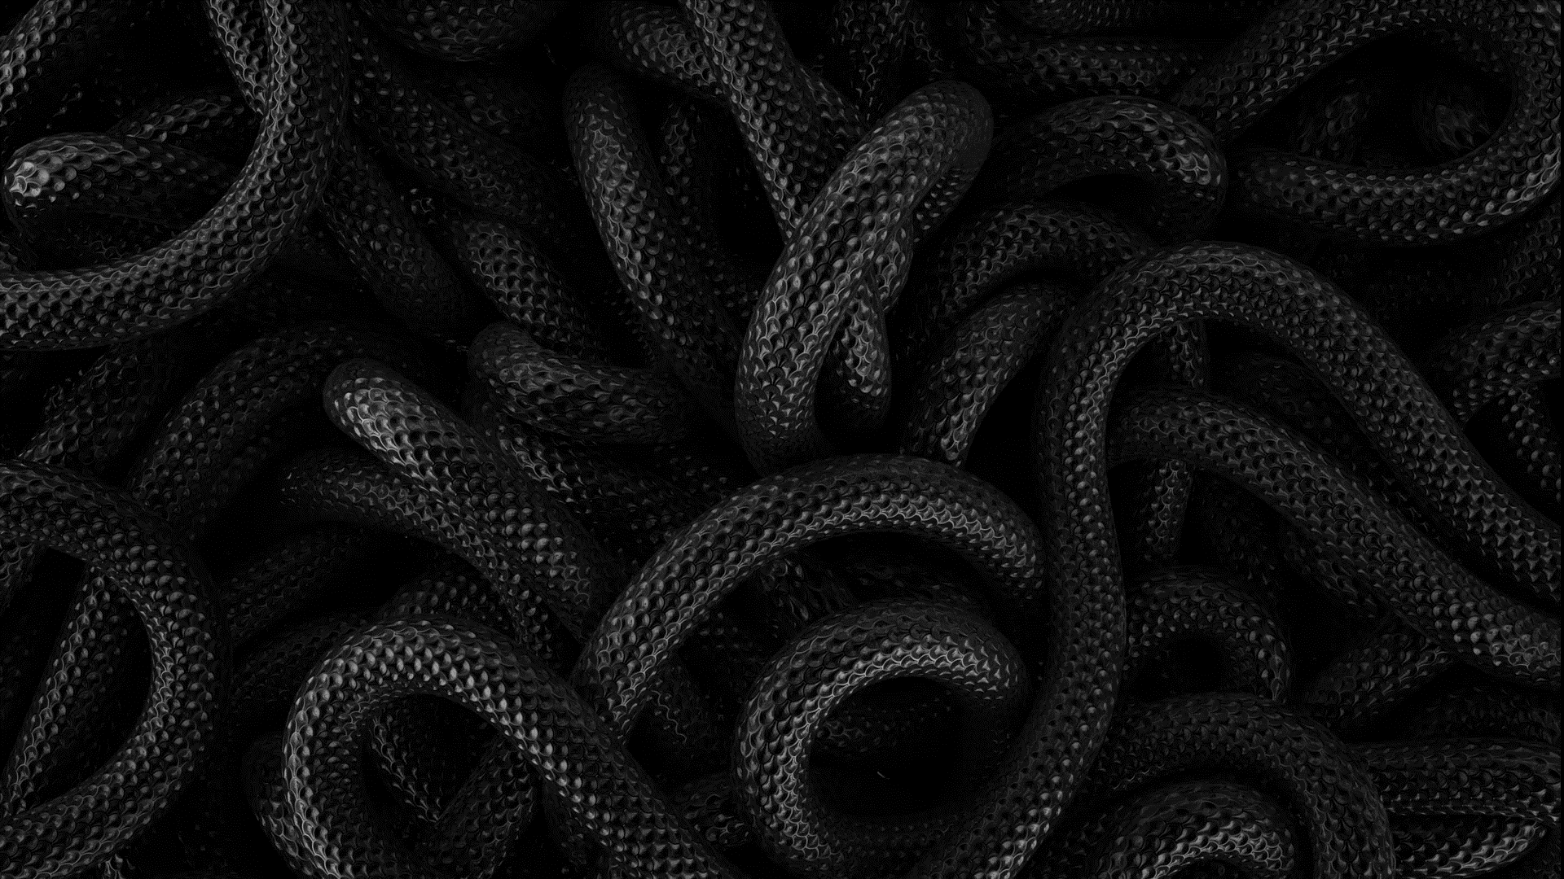
DISCUSSION QUESTIONS
Discuss how Silko’s point of view contributes to your understanding of the arroyos, the turquoise ledges of the Sonoran Desert in Arizona, the desert creatures and landscape, or anything else depicted in the novel. Did she unfairly obscure its reality or open the door to a greater understanding of the location? What resonated with you the most?
When considering the elements of nonfiction, did you have any issues with Silko’s memoir, such as its veracity? For instance, Silko believes all life on earth should be valued and respected, from the rattlesnakes to even the tiniest insects, but she tells us that she visualized the man on the rock-moving machine being “squashed into the humble desert earth” (171). Similarly, what structural possibilities, such as “dipping into the well,” do you think she employed in her writing?
The main characters in The Turquoise Ledge were mainly the desert creatures and landscape. Do you think the nonhuman aspects of the story hinder or bolster the storyline? What are the risks involved when writing about a place or location?

Slide 9
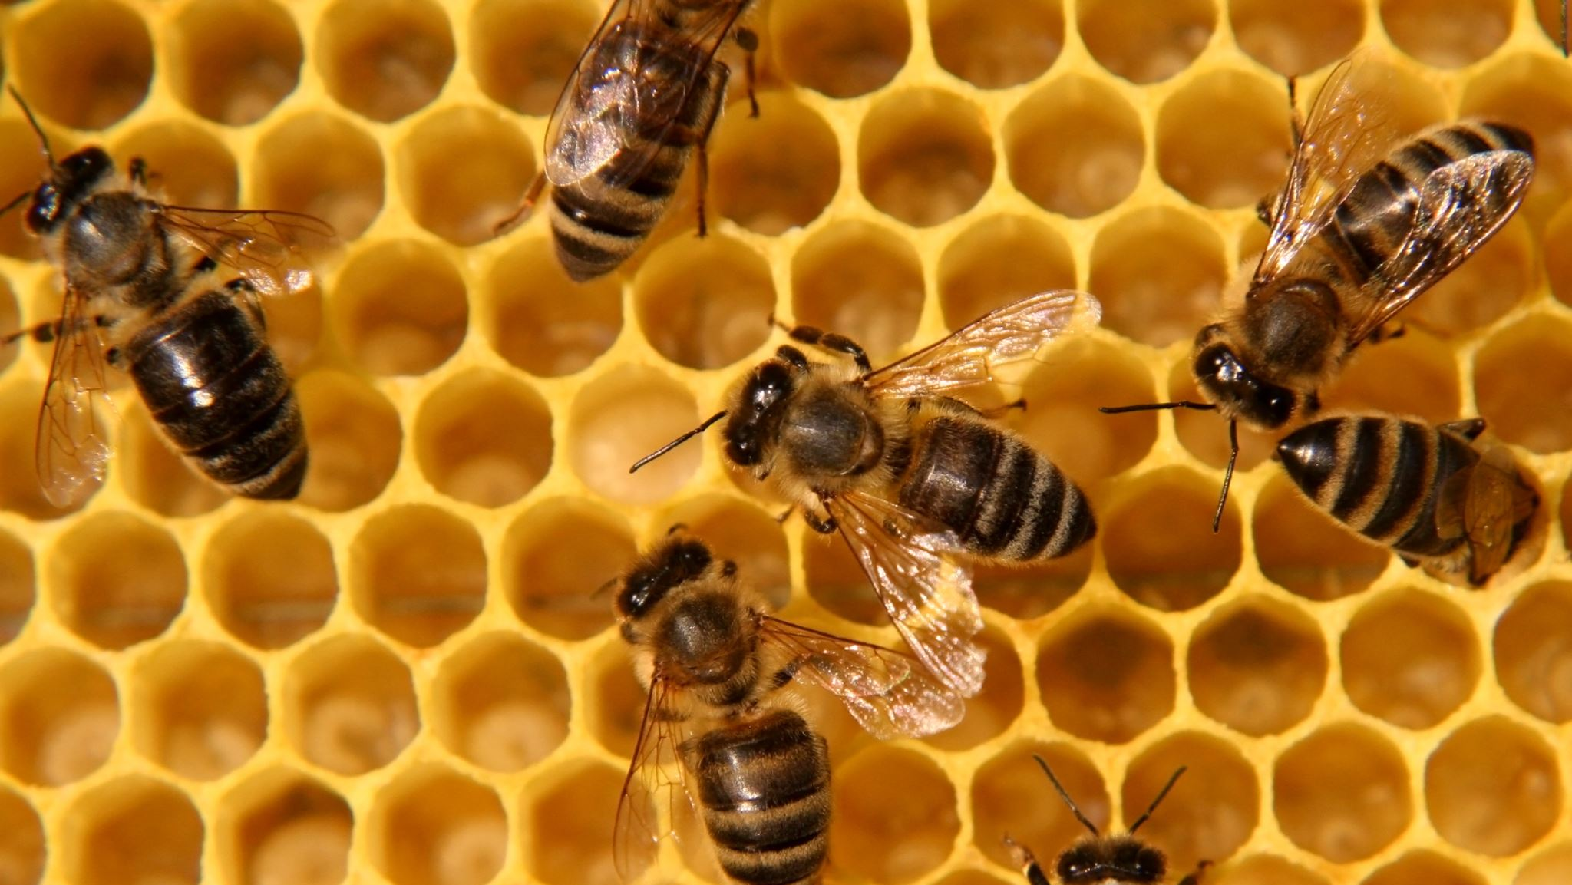
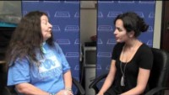
INTERVIEW WITH LESLIE MARMON SILKO

Slide 10
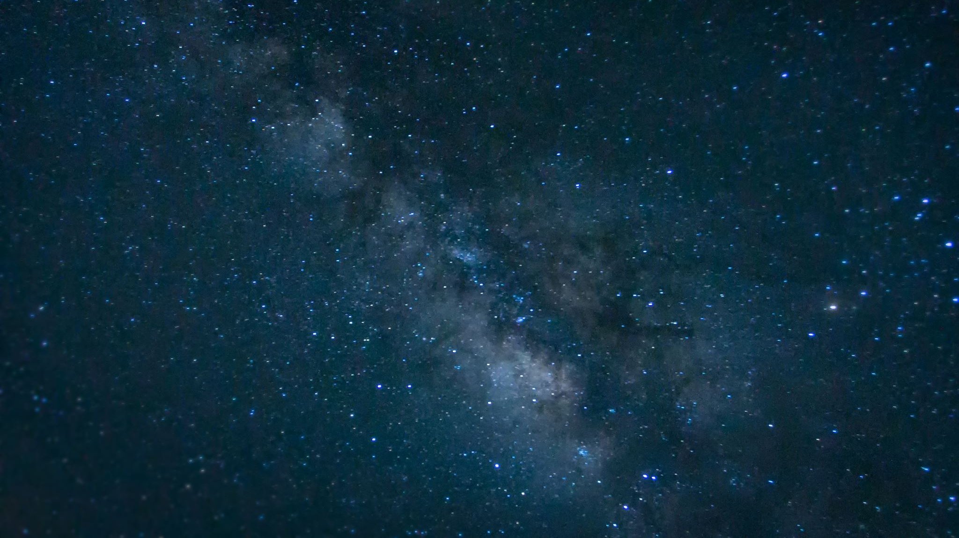
WORKS CITED
Griffith, Jane. “Law, Literature, and Leslie Marmon Silko: Competing Narratives of Water.” Studies in American Indian Literatures, vol. 29, no. 2, 2017, pp. 26–48. JSTOR, www.jstor.org/stable/10.5250/studamerindilite.29.2.0026. Accessed 28 Aug. 2021.
Johnson, Myke. “The Power of the Story.” Finding Our Way Home: A Spiritual Journey into Earth Community, 6 April 2014,
https://findingourwayhome.blog/2014/04/06/the-power-of-the-story/
Otjen, Nathaniel. “Indigenous Radical Resurgence and Multispecies Landscapes: Leslie Marmon Silko’s The Turquoise Ledge.” Studies in American Indian Literatures, vol. 31, no. 3–4, Oct. 2019, pp. 135–157. EBSCOhost, doi:10.5250/studamerindilite.31.3-4.0135.
Silko, Leslie M. “Leslie Marmon Silko, How to Connect to Nature, Even in the City.” YouTube, uploaded by Zócalo Public Square, 19 Nov. 2010, https://youtu.be/g9PH1rd9QTc.

